Slide 1


DATE:01/01/24
……

Slide 2
















GROUP NAME: TECH TURTLES
DATE:01/01/24
PLAN B

Slide 3

















Member 1:
Member 2:
Member 3:
Member 4:
PLAN B

Slide 4









Develop and setup The project structure and create Presentation file.
Project report and analysis.
Helping for develop structure and handle Coding part
Helping coding and slide

Slide 5













The Arduino-based car parking system is a smart solution designed to efficiently manage parking spaces. Using ultrasonic sensors, it detects the availability of parking spots and relays real-time information to a central control unit. This system aids drivers in locating vacant spaces, reducing congestion, and optimizing parking utilization, contributing to a more streamlined and organized parking experience.

Slide 6
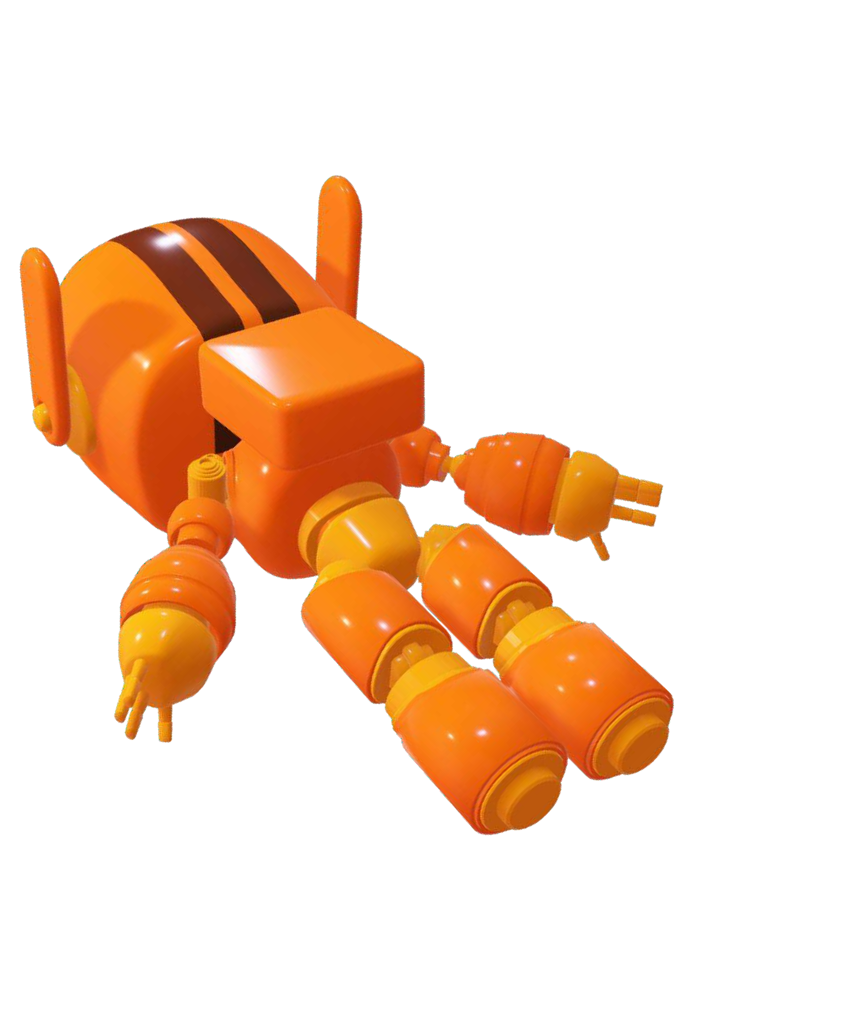




It is An Arduino-based car parking system that intelligently manages both ingoing and outgoing vehicles. Utilizing sensors, the system accurately detects free spaces, guiding incoming cars for efficient parking.
Additionally, it facilitates gate operations for outgoing vehicles, ensuring seamless exit processes and enhancing overall parking management.
.

Slide 7




Objectives and goals
Time Efficient Solution
Reduce Parking Stress
Reduce Search Traffic on Parking Garage
User-friendly Interface
:

Slide 8








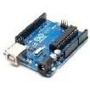
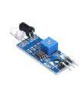

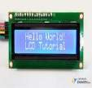
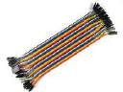







Components
Arduino-Uno
Infrared-Proximity-Sensor
Servo-Motor
Arduino Interfacing-I2C-LCD
Jumping wire

Slide 9
STRUCTURE
CODE
CODE TEST
At last Test The system by placing
obstacles(simulating cars) in
front of the sensor. The gate
should open when an object is detected and close after a few seconds
Firstly, we Mount the ultrasonic sensor near the parking space entrance and the servo motor to control the gate.
Then we Power the Arduino with the Arduino jack.
After Then upload the code to the Arduino using the
Arduino IDE

Slide 10

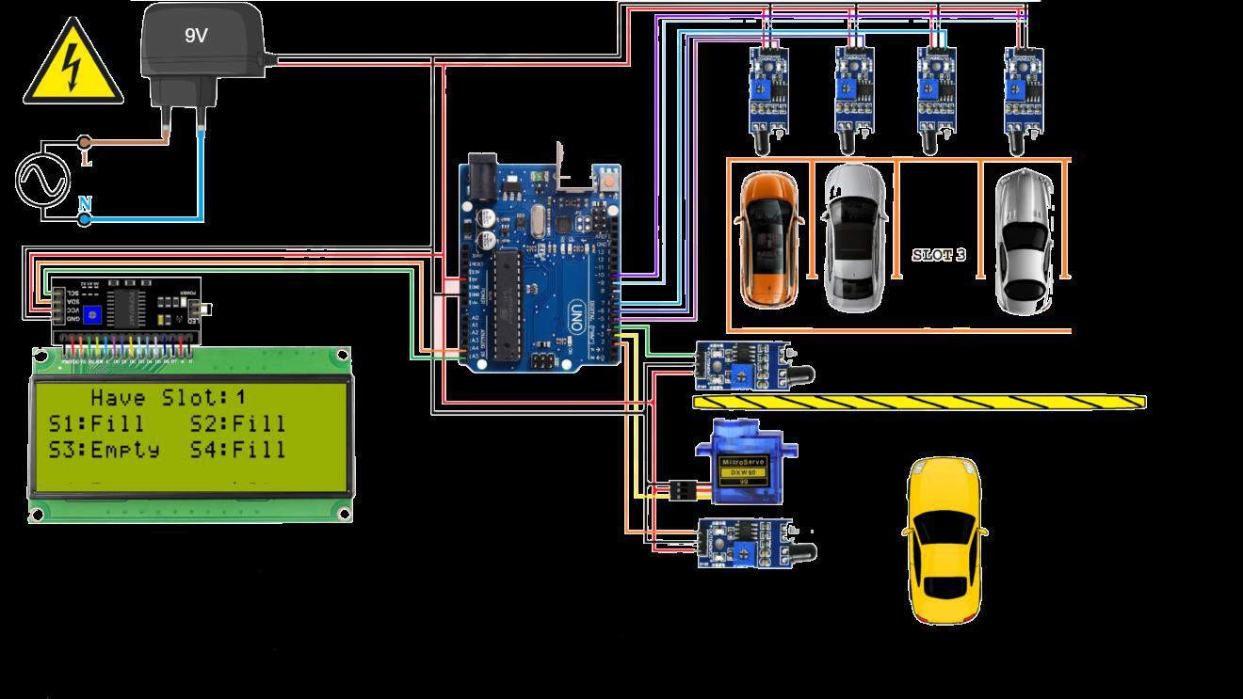



Slide 11










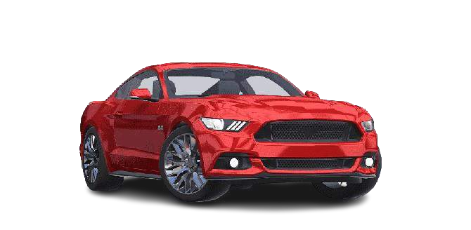












FLOW CHART

Slide 12


The drivers can see the status for the availability of the free space outside the parking on a LCD..
This system is capable of finding the empty slots that are available for parking automatically.
Methodology
scene
If the slot is empty in the automated car parking the new vehicles are allowed to enter the parking else the entrance is blocked by using the servo barrier in case no empty slot is found by the system.
If slot is empty driver can see “E” on the display which means EMPTY. If slot is full driver can see “F” on the display which means FULL.

Slide 13


Importance and relevance of the project
The Arduino-based car parking system is crucial for urban efficiency, offering real-time parking space management and optimization. It minimizes traffic congestion by guiding drivers to available spots, reducing fuel consumption and emissions. Additionally, it enhances overall parking convenience, providing a technologically advanced solution to address the growing challenges of urban parking.
Importance and relevance of the project

Slide 14








In conclusion, the automatic car parking system using the Arduino is an innovative and highly efficient solutions that effectively addresses the challenges associated with conventional parking systems. Throughout the project, we successfully implemented a smart automatic car parking system that provides a real time parking

Slide 15
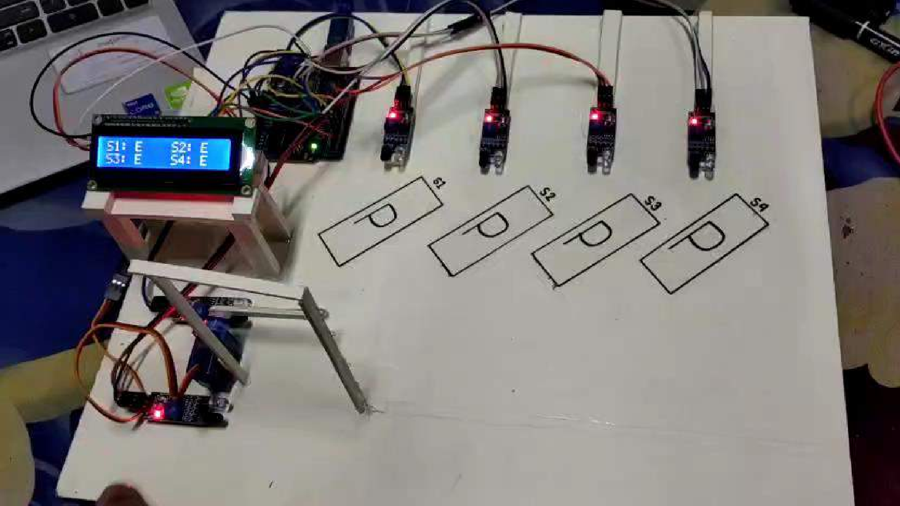

Slide 16


DATE:01/01/24
……

